Slide 1
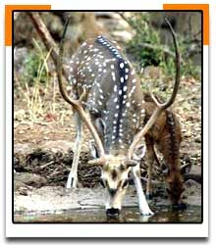

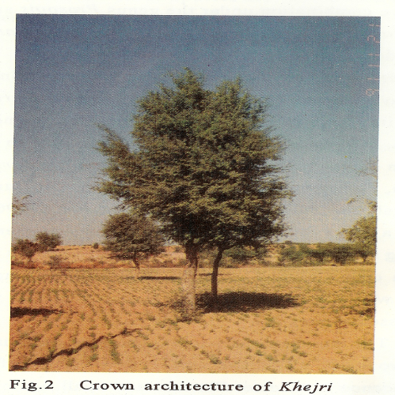
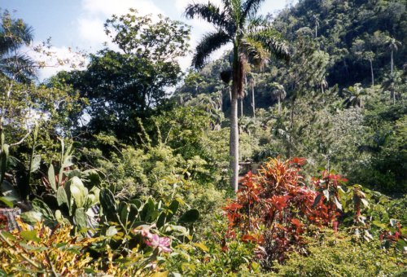
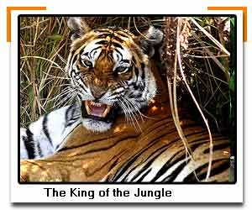

Biodiversity & Its Conservation
Dr. Jabrinder Singh
Asst. Professor (Environmental Science)

Slide 2

Biodiversity ???
Diversity = variety
Bio= living
Thus, variety and variability among living organisms from all sources including inter alia, terrestrial, marine & other aquatic ecosystems and ecological complexes of which they are part of.

Slide 3
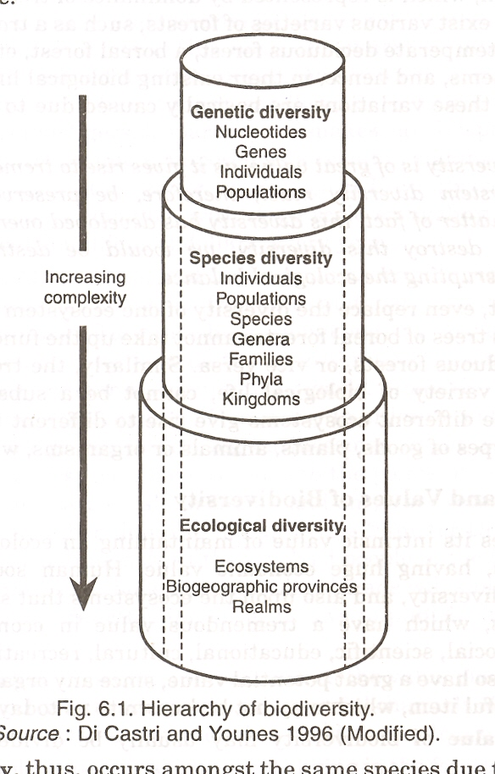
Hierarchy of biodiversity

Slide 4
Levels of Biodiversity….
Genetic
Genes within same species show variation
E.g. Colour & sizes of Rose . Oryza sativa (Rice) has more than 5000 varieties.
Species
Represents species richness & abundance in a community
No. of plants, animals, birds in an area.
Ecosystem
Diversity in complex systems in physical, ecological, food web, nutrient cycling
Diversity in forest
Eg. Forests ecosystem variability: Tropical, Deciduous, temperate, coniferous, arid etc.
Eg. Panthera family variability: P. Leo, P. Tigris, P. Pardus

Slide 5
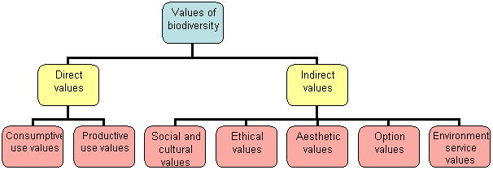
Values of Biodiversity…
It is in terms of commercial utility, ecological services, social & aesthetic Values
Given by McNeely et al. 1990.

Slide 6
Consumptive use Value
In the form of food, drugs, fibre pulp, fuel, wood fall under this group
Food: 80,000 edible plants species are there.
About 90% of present day food crops have been domesticated from wild plants
A large number of wild animals are also source of food.
Drugs & Medicines:75% world’s population is dependent on plants or plant extracts for medicines
Isabgol- cure for bowel disorder obtained from husk of Plantago.
Penicillin- A wonder drug – used as Antibiotic – Fungus Penicillium
Tetracyclin- from bacterium ,Quinine – from Cinchona Tree- medicine for Malaria, Digitalin- from foxglove- for Heart Ailments ,vinblastin & vincristine – Anti-Cancer Alkaloids
Fuel: big source of fuel wood. Firewood collected by individuals are direct consumptive value

Slide 7
Productive Use Values
These are commercially usable values where the product is processed, marketed & sold.
Musk Deer- production of Musk , Silk Worm- Silk, wool from sheep, lac from insects.
Many industries are dependent on these products, e.g. pulp & paper industry, silk industry, ivory work, pearl industry, leather industry.
Problems--- trading of products from endangered species.
E.g smuggling of fur, horns, tusk, Snake Skin, cat skins.
Rich biodiversity are exploited.
Social / Religious Values
Values associated with social life, rituals & customs, religion and pyscho-spiritual aspects of the people.
Many plants are considered holy & sacred. Eg. Tulsi, Mango, Peepal, Khejri etc.
Social life, songs, dances, customs are woven with surrounding wildlife
Cow, snake, goat, bull, deer and many birds have special value in biodiversity

Slide 8
Ethical Value
“All Life must be preserved” based on “Live and let live”.
Every organism has the right to sustain on this planet and utilize the resources
This means we don’t use the species directly or indirectly, but we feel sorry about the loss of a species.
E.g. Passenger Pigeon or Dodo
They have an existence value
Aesthetic / Ecotourism Value
It is related to the scenic beauty of Biodiversity
The pleasure, excitement and visual peace of any area
Concept of Eco-tourism and willingness to pay are gaining grounds, leading to monetary estimate for aesthetic value of biodiversity

Slide 9
Option/ Research Value
This includes the potentials of biodiversity that are presently unknown and need to be explored.
This biological resources will be of importance in future if not today
Eg. Marine animals – anti cancer drugs, nutraceuticals.
Catharanthus (periwinkle) provide vincristine and vinblistine alkaloids act as anti-cancer drugs
Ecosystem Service Value
It refers to ecosystem services, it is a non-consumptive value.
Each organism is a vital component of ecosystem (food chain & webs). Ecosystem services are provided by every organism.
Ecosystem Services- nutrient cycling, nitrogen fixation, cycling of water, gaseous exchange, etc. It is the invaluable significance of biodiversity.

Slide 10
Global Biodiversity….
Currently about 1.9 million species are known,
1.55 Million Living species and 0.35 million fossil species (Extinct species).
Thought to be a significant underestimate of the total number of species. It is estimated that, there may be more than 5-50 million species on this planet as described below :
3-30 million insects;
5-10 million bacteria;
1.5 million fungi;
1 million mites
3.2 million – Plants
1.36 million animals, including: 1.30 invertebrates 0.6 million vertebrates

Slide 11
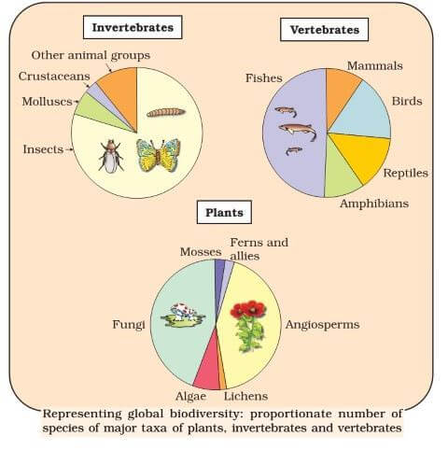
Global Biodiversity

Slide 12
Did u know this..?????
50 to 80% of Biodiversity is in dense rain forests.
Deserts show minimum biodiversity
Many species are identified everyday…
List goes on increasing
Marine biodiversity is extremely high.
1,25,000 flowering plant species are in Tropical forests
Roughly 1.5 million living species are nomen-clatured till date which may be just 1-15% of actual number.

Slide 13
Biodiversity at National Level (Indian)
India is one of the 12 mega diversity countries of the world.
2.4% of the land area, accounting for 7-8% of the species of the world.
10th among plant rich countries
11th in number of endemic species of higher vertebrates
6th in terms of centres of origin in biodiversity
3 hot-spots of biodiversity in India among 34 at global level
Ministry of Environment and Forests records (as of 2010)
47000 plants: 7% of global.
91000 species of mammals: 6.5% of global.
Large numbers are ENDEMIC & ORIGINATED in India.
5000 flowering plants..
340 corals
More than 10 biogeographic zones

Slide 14
India – as a Mega-Diversity Nation
Endemism- species which are restricted only to a particular area. Eg. 50% Lizards are endemic to India. Western Ghats are the site of maximum endemism. (India ranks 11th in endemism)
Center of origin: Approx. 5000 species of flowering plants, 166 species of cropping plants and 320 species of wild relatives of cultivated crops have their origin in India (Rank 6th )
More than 47000 sp. of Plants & 90000 sp. of animals (7% global biodiversity).
Ranks 10th in richness of biodiversity.
Marine Diversity: India has 7500 Km long coastline having (mangroves, estuaries, coral reefs, black waters) rich biodiversity.
More than 340 species of corals are found in India
Rich in Mollusks, crustaceans, polychaetes, corals
93 major wetlands, Large Forest Cover with variability.

Slide 15
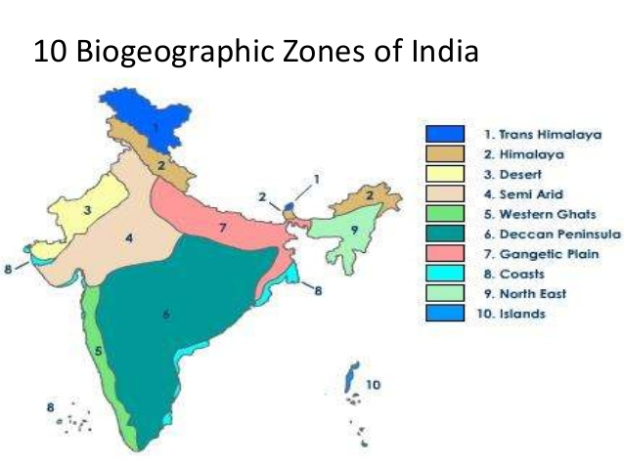
Biogeographical Regions of India

Slide 16
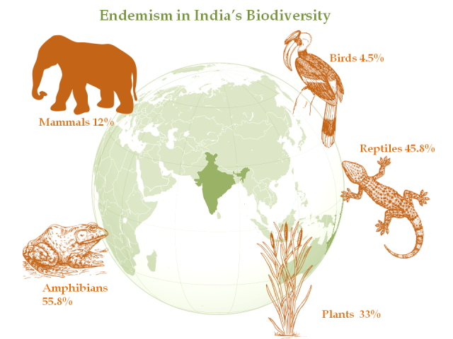
Endemism

Slide 17
Hotspots of Biodiversity
A biodiversity hotspot is a biogeographic region with a significant reservoir (rich biodiversity zone) of biodiversity that may under threat from human induced activities.
Areas which exhibit high species richness as well as endemism are termed as Hotspots of Biodiversity.
Myers et al introduced this term, at that time 25 Hotspots were identified out of which 2 were in India. Later 9 were added more bringing a total to 34.
About 40% terrestrial & 25 % vertebrate are endemic found in this hotspots
After tropical rain forests the second highest number endemic species are found in Mediterranean
These hotspots are threatened by human activities. More than 1 billion people most whom are desperately poor people, live in these areas.
Measures protecting these areas should be planned.

Slide 18
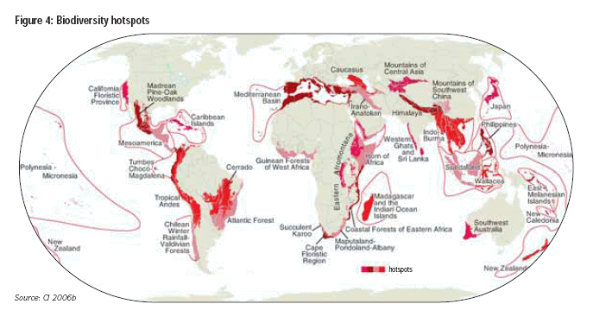
Biodiversity Hotspots

Slide 19
List of Hotspots
Sr. No | Name of Hotspots | Sr. No | Name of Hotspots
1 | Tropical Andes | 19 | Indo-Burma
2 | Mesoamerican Forests | 20 | South Central China
3 | Caribbean | 21 | Western Ghats
4 | Brazil’s Atlantic Forest | 22 | South-Western Australia
5 | Choc/Darien of Panama Western Ecuador | 23 | New Caledonia
6 | Brazil’s Cerrado | 24 | New Zealand
7 | Central Chile | 25 | Polynesia/Micronesia
8 | California Floristic Province | 26 | The Madrean Pine-Oak woodlands
9 | Madagascar | 27 | Maputaland-Pondoland Albany
10 | Eastern Arc & Coastal forest of Tanzania/ Kenya | 28 | The eastern Afromontane
11 | Western African Forest | 29 | The Horn Africa
12 | Cape Floristic Province | 30 | The Irano-Anatolian
13 | Succulent Karoo | 31 | The Muntains of Central Asia
14 | Mediterranean Basin | 32 | Eastern Himalaya
15 | Caucasus | 33 | Japan
16 | Sundaland | 34 | East Melanesiaan Islands
17 | Wallacea
18 | Phillipines

Slide 20
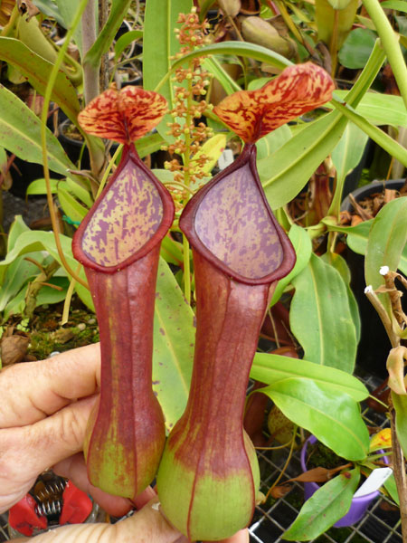
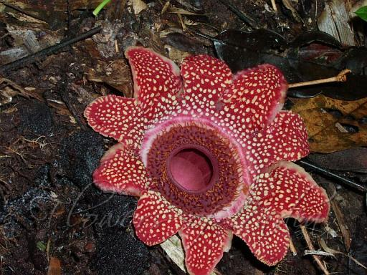
North-Eastern Himalayas
Many deep and isolated valleys in Sikkim.
35,000 recorded flora endemic to Himalayas
4250 species in Sikkim (7000km2) of which 60% endemic
Sapria himalayana: a parasitic angiosperm seen only twice in last 70 years & Nepenthus is also endemic & endangered

Slide 21
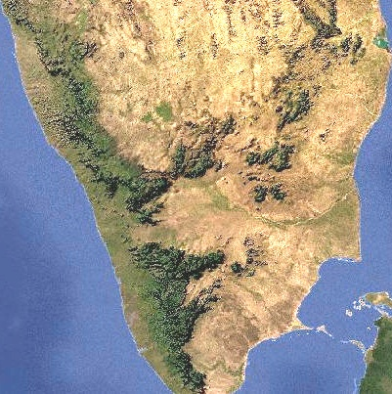
Western Ghats
17000 km² strip of forests
20% forest Evergreen and semi-evergreen
4 states: Maharashtra, Kerala, Karnataka and Tamil Nadu
40% endemic plants
62% amphibians are endemic
50% lizards are endemic
Agastyamalai hills, Silent Valley, New
Ambamalam Reserve basin
Under alarming threat due to human
activities and resource extraction pressure

Slide 22
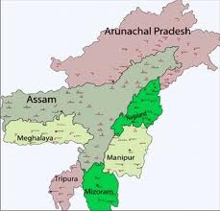
INDO-BURMA
East of Ganges – Brahmaputra lowland
Indian states of Manipur, Mizoram, Tripura, Meghalaya, Nagaland, South Assam & Island groups
One of the most densely forested regions of the country
13,500 species of plants out of which 7000 endemic
1260 species of birds
430 mammals

Slide 23
Threats to biodiversity
Anthropogenic causes
Loss of habitat
Hunting / Poaching
Man- wildlife conflict
Introduction of exotic varieties
Pollution
Global warming and Climate change
Natural causes
Narrow geographical area create conflicts
Low population
Low breeding rate
Natural disasters
Calamities

Slide 24
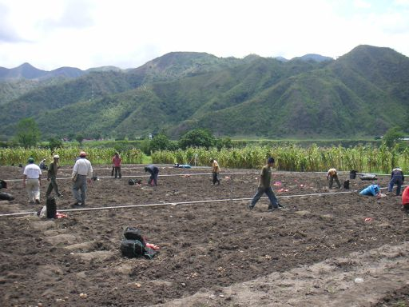
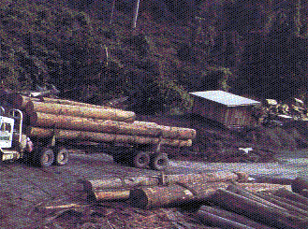
Loss of habitat
Continuous increase in human population and escalating demand for our natural resources
Conversion of forested land to agriculture.
Loss of habitat to grazing land, industries, roads and cities.
Habitat loss leads to the formation of isolated, small, scattered populations.
These small populations are increasingly vulnerable to inbreeding, which causes loss of gene pool, high infant mortality and susceptible to environmental changes, which all may lead to extinction of the species.

Slide 25
Poaching
Hunting for various body parts.
Illegal trade of skins, tusks, hair, horns
Many animals fall prey to various traps
International market very active
Tibet, Nepal & China
Tiger skins, rhino horn, elephant tusks etc
Easy trap by tribal communities.

Slide 26
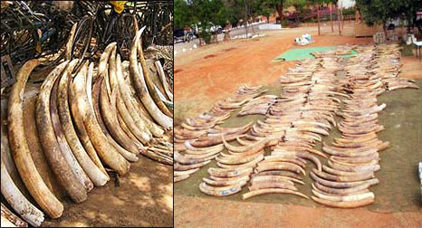
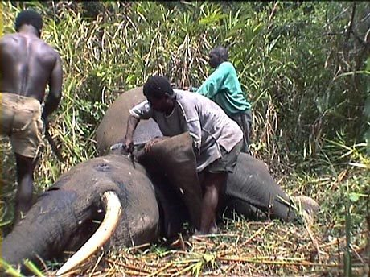
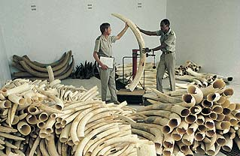
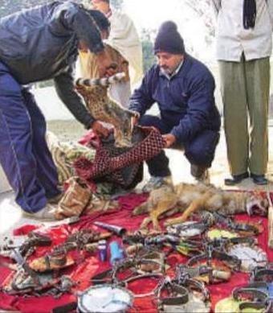
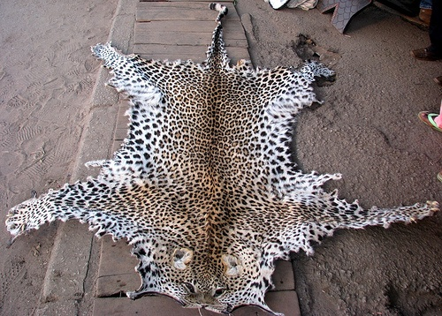

Slide 27
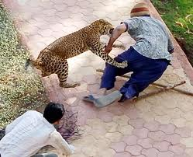
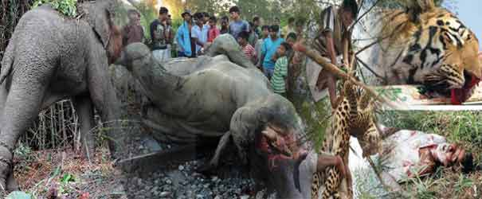
Man Animal conflict
When animal enters human territory and kills
From fear
In search of prey
Habitat encroachment

Slide 28
Pollution
Oil Spills / Marine pollution
Bio-magnification
Water pollution / Plastic accumulation
Noise / Air Pollution
Nuclear pollution
Thermal / Soil

Slide 29
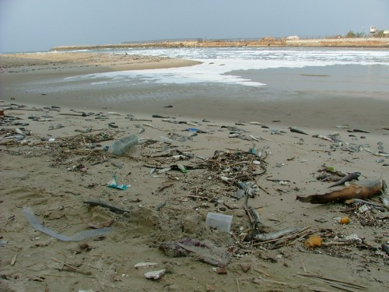
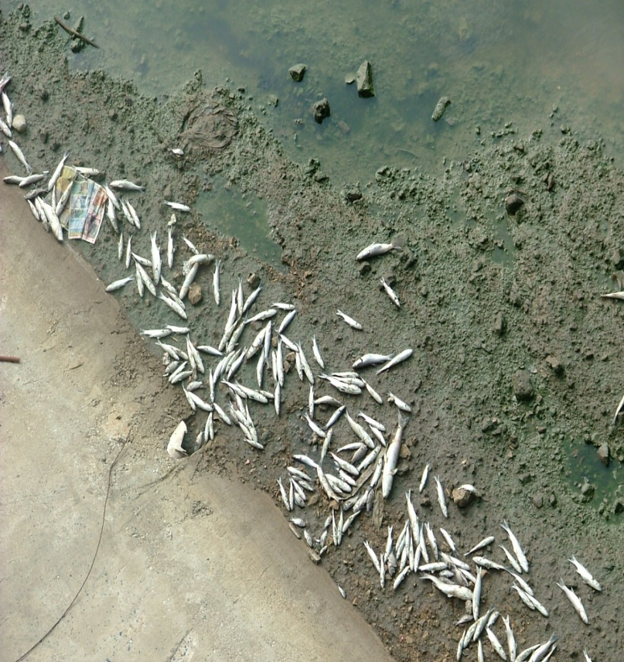
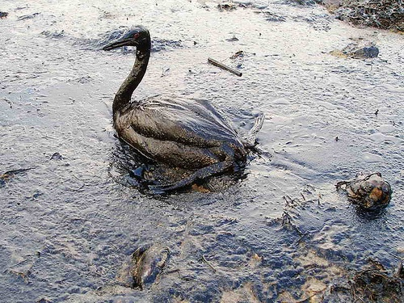
Oil Spillage

Slide 30
Introduction of Exotic / Invasive species
Introduced from outside.
Harm the growth of local species.
Entire population wiped out
Competition for resources
Eg: Parthenium -Congress grass in all habitats.
Some exotic species like Eucalyptus, Australian Acacia and tortilis have been introduced in India for afforestation and cause threats for Indigenous species.

Slide 31
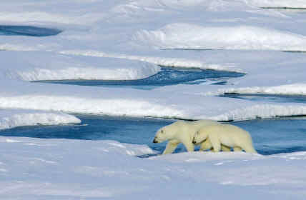
Global Warming and Climate Change
As temperatures increased in recent decades, certain species began breeding and migrating earlier than expected.
Other studies found that the geographical range of numerous species had shifted pole ward or moved to a higher elevation -- indicating that some plants and animals are occupying areas that were previously too cold for survival.
Decline in breeding
populations

Slide 32
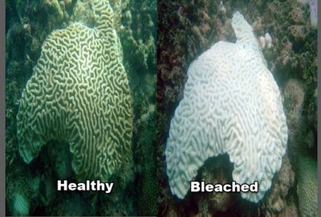
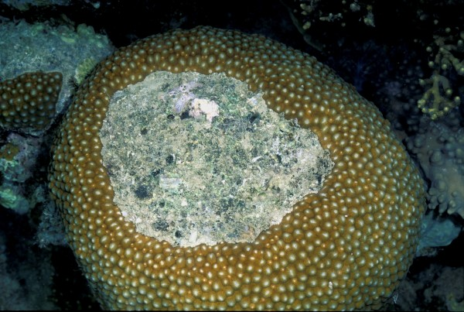
Coral Bleaching
Increase in temperature causes bleaching.
The Great Barrier Reef along the coast of Australia experienced bleaching events in 1980, 1982, 1992, 1994, 1998, 2002, 2006, 2012, 2016 etc.
While most areas recovered with relatively low levels of coral death, some locations suffered severe damage, with up to 90% mortality

Slide 33
Threatened Categories…..
World Conservation Union (formerly IUCN)
There are 4 clearly defined categories into which every taxon in the world (excluding :micro-organisms) can be classified as given in RED DATA BOOK
Extinct species
Endangered species
Vulnerable species
Rare / Endemic species

Slide 34
Categories
EXTINCT (EX)
A taxon is Extinct when there is no reasonable doubt that the last individual has died. No reasonable record for last 50 years. It has been not seen wildly in the past 50 years.
e.g Indian Cheetah, Dodo
EXTINCT IN THE WILD (EW)
A taxon is Extinct in the Wild when it is known only to survive in cultivation, in captivity or as a naturalized population (or populations) well outside the past range.
e.g Mulberry Silk moth

Slide 35
CRITICALLY ENDANGERED (CR)
This includes species, which are facing an extremely high risk of extinction in the wild in the immediate future. The population of such species is very low and the threats to its habitats are very high. E.g. Asiatic Lion, Vultures
ENDANGERED (EN)
It includes species that are not critically endangered but are in danger of extinction if the threats to its survival continue operating. Also, species whose numbers have been reduced to a critical level or whose habitats have been so drastically reduced are deemed to be in immediate danger of extinction. E.g. Tiger, snow leopard, Red panda

Slide 36
VULNERABLE (VU)
It includes species that are not endangered but are likely to move into the endangered category in the near future if the threats to its survival continue operating. It also includes species whose populations are still abundant but are under threat from severe adverse factors throughout their range. E.g. Asiatic Elephant, Most of the tree species are categorized in this.
Eg. Rhododendron sp. Pine species.

Slide 37
Rare / Endemic
This includes species with small populations in the world that are not at present endangered or vulnerable, but are at risk. These species are usually restricted within specific geographical areas or habitats or are thinly scattered over a more extensive range. E.g. Himalayan rafflesia, Lion tailed macaque, Nepenthus khasiana, One horned rhino.

Slide 38
Endangered species of India
According to the Red Data Book of International Union for Conservation of Nature (IUCN), there are more than 47 critically endangered species in India.
The number of endangered species in India accounts for around 8.86 % of the world`s mammals. The mammals are extended over 186 genera, 45 families and 13 orders out of which around 89 species are listed as threatened in the IUCN Red List of Threatened Animals.

Slide 39
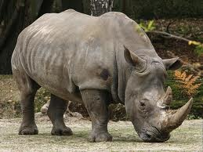
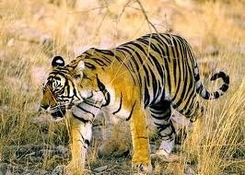
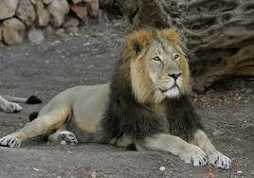
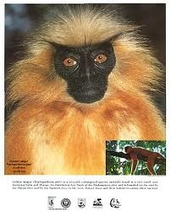
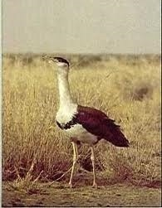
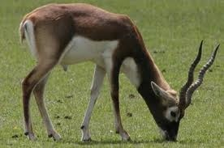
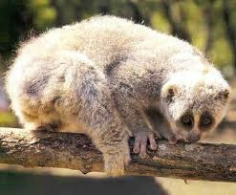
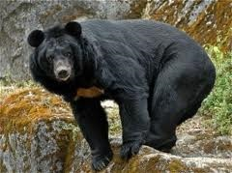
Threatened Biota

Slide 40
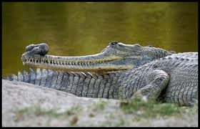
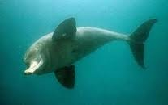
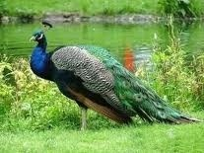

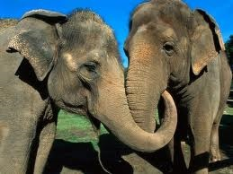
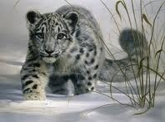
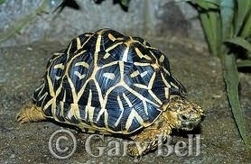
Threatened Biota

Slide 41
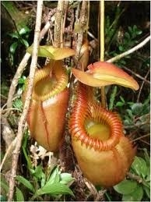
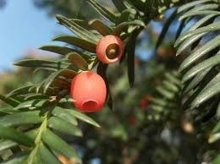
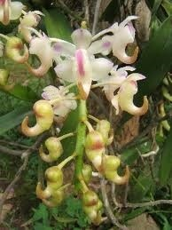
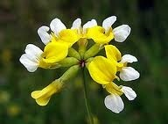

Threatened Biota

Slide 42
Extinct Species…..

Slide 43
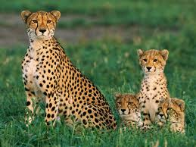
Asiatic Cheetah (Acinonyx jubatus ssp. venaticus)
Extinct in India since 1952.
It lives in open semi-arid grassland, savannah, scrub or isolated low hillocks amidst plains
Fastest animal on land and can achieve terrific speeds of 115-120 km/h
Drier parts of southwestern and central Asia to India. In the past, the species used to occur in northern and central India.
Presently extinct in India; now found in USSR and in northeastern Iran as scattered survivor.
Main cause of extinction of this magnificent
cat was destruction of habitat due to
increase in human habitation and
overgrazing by domestic stock.

Slide 44
Pink Headed Duck (Rhodonessa caryophyllacea)
Size of a domestic duck. 60 cm in length.
Its bill was reddish pink, eyes red orange and its feet dark with a red tint. It was not only unique in having a pink head and neck, but was also the only duck to lay perfectly spherical eggs which looked like unpolished billiard balls.
Its habitat was tall grassland, floodplains and small lakes and ponds.
This bird was shy and secretive, and was rarely seen.
Resident of northern and northeastern India (Orissa, Bihar, Bengal, Assam and Manipur) in the forested foothills of the Himalayas and the adjoining plains. Some were also recorded as winter visitors to Punjab, Uttaranchal, Maharashtra, A P and T N.

Slide 45
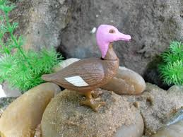
Status: Probably extinct, but until the last known area of its former range is surveyed, this cannot be confirmed.
Its population started declining as early as 1878, obviously due to the shrinkage of its habitat and hunting.
The last authentic sight record was in June 1935 (Darbhanga, Bihar).
From 1984-1990, under the
Project Endangered Birds, BNHS
carried out intensive surveys to
rediscover the bird,
but were unsuccessful.

Slide 46
Endangered Flora...

Slide 47

Western Flytrap (Ceropegia fantastica) “Critically Endangered”
A slender twiner that grows in open semi-evergreen forests among bushes on latertic soil
Distribution: Endemic to Western Ghats.
Status: Critically endangered as it has been threatened by habitat loss and absence of any conservation measures undertaken.

Slide 48

Dalzell’s Frerea (Frerea indica) “Endangered”
Introduction: A rare, endangered and endemic plant, originally found by Nicole Alexander Dalzell on a hill near Junnar where now it survives in very limited numbers.
It has not been seen in other similar habitats in the adjoining hilly areas, which are being denuded and eroded.
The species grows on exposed bare rocks of hill slopes and cliffs.
Distribution: Being locally endemic, it is found in Junnar and Purandhare Hills, Pune District, Maharashtra.
Status: Besides being endemic and rare, it has also been declared as one of the world’s 12 endangered species listed by the IUCN.
Collection and export of this species is banned.

Slide 49
Endangered Fauna….

Slide 50
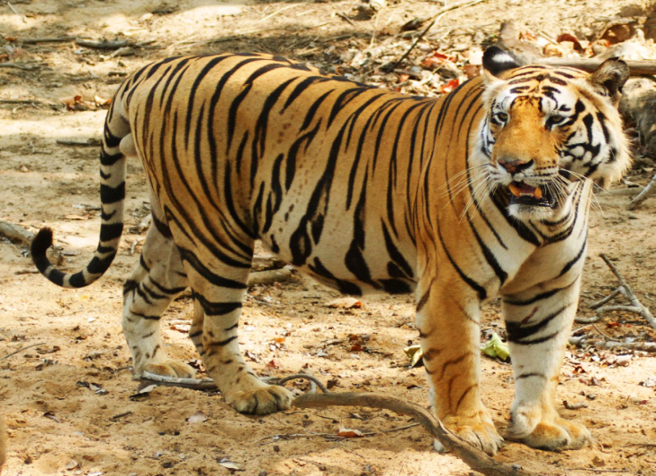
Tiger (Panthera tigris) “Endangered”
Our national animal, graceful, royal, elegant.
It lives in varied habitat like dry open jungles, humid evergreen forests and mangrove swamps.
Distribution: Found practically throughout India except the deserts of Rajasthan, Gujarat, Punjab, and higher reaches of Himalayas. The number of tigers is negligible in Goa, Haryana, Tripura and Manipur.
Status: At present 3000.
Illegal poaching and loss of
habitat have endangered the tiger.
Project Tiger started in 1973.

Slide 51

Asiatic Lion (Panthera leo) “Critically Endangered”
A large powerfully built cat.
Distribution: A little over 100 years ago, the Asiatic Lion ranged from western Iran to eastern India. During the 19th century, it was reported in India from Gujarat to Bihar.
However, by the second half of the 20th century it had been wiped out of its entire range except Sasan Gir in Gujarat.
There are just 359 individuals left alive in India.
The main threats are poaching, loss of habitat
to agriculture, decline in number
of prey species, overgrazing by
domestic stock and others.

Slide 52

Asian Elephant (Elephas maximus) “Endangered”
Elephants are forest animals requiring a shady environment but having free access to grasses, an important part of their diet and water.
Distribution: In India, they are found in northern Uttar Pradesh, Bihar, Orissa, West Bengal, northeastern India, Karnataka, Tamil Nadu and Kerala.
26,390-30,770 are found in India
The major threat to elephant populations in India is the degradation and fragmentation of its habitat because of the human population explosion and consequent development.
Poaching of elephants for ivory is still a serious problem in India. As only male Asian elephants have tusks, males are heavily poached.
Elephant Project was started in 1992 by the Government of India

Slide 53

Indian Vulture (Gyps Bengalensis, G. Himalayensis) “Endangered”
Indian Vultures are listed as critically endangered, now only breed on high human-made structures in Rajasthan and Madhya Pradesh. The Indian vulture along with the white-rumped vulture and slender-billed vulture died of renal failure caused by diclofenac poisoning. Vulture breeding centres were established in India, Nepal and Pakistan for its recovery. The project was initiated in 2001 . 1st Vulture breeding centre was established at Pinjore (HR).

Slide 54

5. Lion-tailed Macaque (Macaca silenus) “Endangered”
Distribution: Endemic to India and is known to occur in the Western Ghats from North Kanara southwards to Kerala and Kanyakumari District, Tamil Nadu.
Status: Today, less than 2500 mature individuals are surviving
The shrinkage of habitat has brought about a considerable decrease in the population of this macaque. Diversion of
forests for large irrigation, power and mining projects and extension of roads are not only responsible for the loss of habitat but have even opened up inaccessible areas to human beings.
Modified land use for agriculture, extension of coffee and tea plantations and replacement of endemic forest trees by exotic species like eucalyptus and wattle are the major factors for the reduction in its numbers.
Some locals are also killing it for fur trade and the supposed aphrodisiac and medicinal properties of its flesh.

Slide 55
Man-wild life conflicts:
Conflicting situations – wild life starts causing immense damage and danger to man – forest department and local people
ex: Sambalpur, Orissa – 195 humans are killed in last 5 years by elephants – in retaliation villagers killed 98 elephants and badly injured more than 30 elephants.
Similarly incidents of tigers, leopards etc.
Shrinking forest cover, human encroachment, ill and weak animals, lack of food (one adult elephant needs 200 kg green fodder and 150 kg of clean water), villagers put electric fence, compensation by Govt. is not enough, conflicts between forest dept. and villagers –
Kailadevi wild life sanctuary, Rajasthan – local community – protection – banning mining, using resources judiciously etc.

Slide 56
Biodiversity Conservation
Considering the rich diversity and the threats conservation of this vast biodiversity is very important
2 major approaches
In-situ conservation (at the place)
Ex-situ conservation (out of the place)

Slide 57

Conservation Measures

Slide 58
Protected Areas
Protected areas are locations which receive protection because of their recognized natural, ecological and/or cultural values.
There are several kinds of protected areas, which vary by level of protection depending on the enabling laws of each country or the regulations of the international organizations involved.
"protected area" also includes Marine Protected Areas, the boundaries of which will include some area of ocean, and Transboundary Protected Areas that overlap multiple countries which remove the borders inside the area for conservation and economic purposes.
Protected areas are essential for biodiversity conservation.
India has 668 PA’s with a total area of 1,61,221.57 sq.km i.e 4.9% of total geographical area

Slide 59
List…..
Sr.No | Category of PA | Total Number in India
1. | Biosphere Reserve | 18
1 | National Park | 102
2 | Wildlife Sanctuaries | 515
3 | Conservation Reserves | 47
4 | Community Reserves | 4
5 | Tiger Reserves | 40
6 | Elephant Reserves | 30

Slide 60
Biosphere Reserve
Biosphere Reserve: A Man and Biosphere (MAB) Program under UNESCO in 1970 to reconcile the Human –Wildlife relations and protect endangered species at global level.
These are fenced protected areas meant for conservation of threatened biota. It consist various zones for specific activities.
Core: No human interference is allowed in core zone
Buffer: Limited Research Activities are allowed
Transition: A limited educational, research and training activities are allowed for limited hours.

Slide 61
National Parks
A National Park is an area where the natural or historical objects of national significance are protected along with the wildlife therein, in such manner and by such means, as will leave them unimpaired for the enjoyment of future generations.
Such protected areas are created by Central Legislation and enjoy highest level of legal protection.
They usually form the focal area of the Project Tiger Reserves.
The human activity is confined to management duties and controlled tourism, strictly enforced by law.

Slide 62
Wildlife Sanctuary
A Wildlife Sanctuary is a place where some rare, wild, indigenous mammals, birds, reptiles and any other form of wildlife are found in good numbers and represents a region that needs protection together with the natural environment.
Limited Human activities are allowed in outer zones such as livelihood needs of tribals / rurals.
The State Forest Department creates such protected areas.
The Chief Wildlife Warden monitors human activities such as livestock grazing, collection of forest produce and tourism, within the sanctuary’s precincts.

Slide 63
TIGER RESERVES
Biosphere reserves and National Parks are areas of terrestrial and coastal ecosystems promoting solutions to reconcile the conservation of biodiversity with its sustainable use. They are internationally and nationally recognized, nominated by national governments and remain under sovereign jurisdiction of the states where they are located.
Some are also converted to Tiger Reserves after Project Tiger (1972)
Tiger reserves are operated by state forestry departments “to ensure maintenance of viable populations of the conservation dependent Bengal tigers in India.
The Tigers are maintained for their scientific, economic, aesthetic, cultural and ecological values and to preserve for all time areas of biological importance as a national heritage for the benefit, education and enjoyment of the people”.

Slide 64

Tiger Reserves: 40 NP’s are TR

Slide 65
Important National parks , Sanctuaries
Biosphere Reserves (18):
Nilgiri Biosphere Reserve
Nanda Devi Reserve
Sunderbans
Kanchenzonga
Great Nicobar
National Parks (100):
Jim Corbett National park
Kanha
Ranthambore
Bandhavgarh
Periyar
Rajaji
Sariska
Gir
Kaziranga
Sanctuaries (500):
Bharatpur Bird Sanctuary
Chail deer sanctuary
Sultanpur Bird Sanctuary
Wild Ass
Jaldapara
Nagzira
Radhanagari
Great Indian Bustard
Mt. Abu Wildlife Sanctuary

Slide 66


Slide 67


Slide 68


Slide 69


Practiced Conservation Measures
Gir Sanctuary Project
Project Tiger
Himalayan Musk Deer Project
Project Hangul
Crocodile Breeding Project
Vulture Breeding Project

Slide 70
Ex situ conservation
Zoological Parks (196 zoos across country).
Botanical Gardens (34 botanical gardens).
Tissue Culture Centres.
Gene bank/ Genetic repository.
Incaptive Breeding Centres.
Seed Banks / Semen Banks.
Artificial Insemination / Clone Labs.

Slide 71
Legislation and Organizations
Indian Wildlife Protection Act, 1972
Biological Diversity Act, 2002
CITES : The Convention on International Trade in Endangered Species of wild fauna and flora.
World Conservation Union (formerly IUCN)
The International Union for the Conservation of Nature
Indian Board of Wildlife(IBWL)
WWF: Worldwide Fund for Nature
BNHS: Bombay Natural History Society
Wildlife Instt. of India, Dehradun
National Biodiversity Authority, Chennai.

Slide 72


THANK YOU

